Slide 1

R-projects
- Everything in its right place
Notes:
What is reproducible research? Generally considered replicable if there is sufficient information available for independent researchers to make the same findings using the same procedures

Slide 2
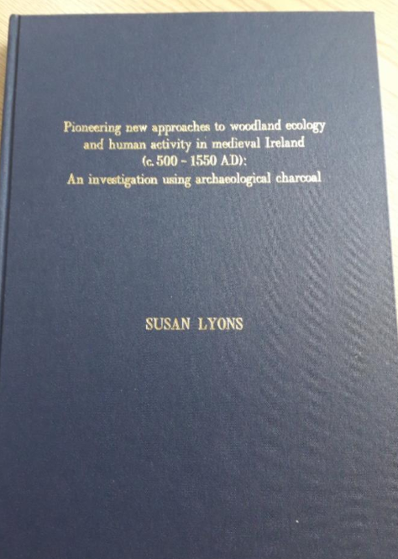
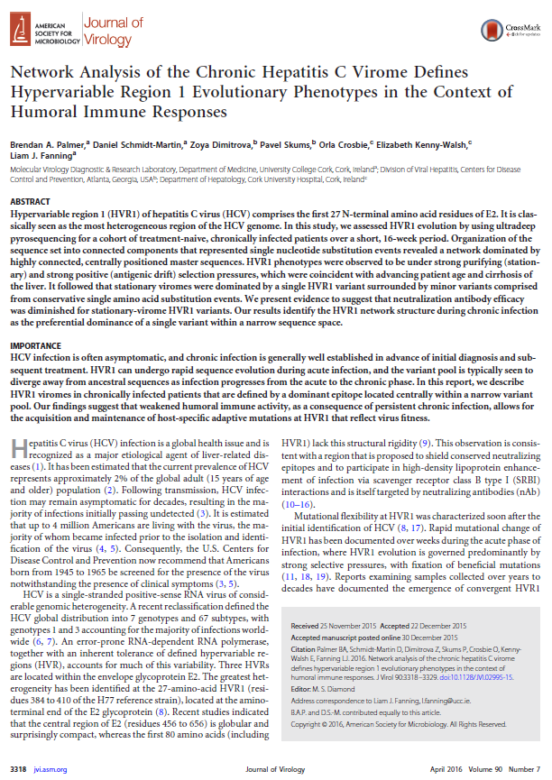
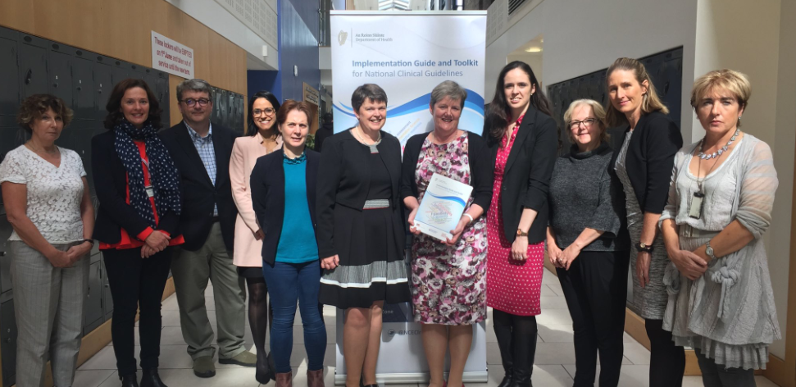
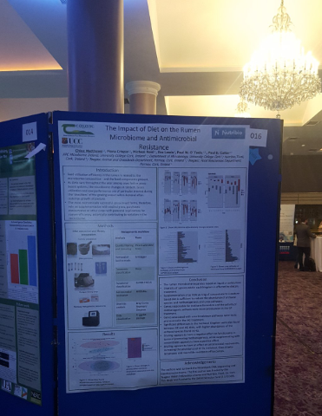
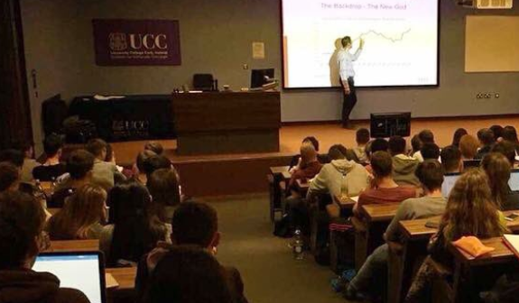
How is research presented?
Theses
Papers
Books
Posters
Talks
Notes:
It’s important to remember that these documents are not the research. Especially in the computational and statistical sciences, these documents are the “advertising”. The research is the “full software environment, code, and data that produced the results”. When we separate the research from its advertisement we are making it difficult for others to verify the findings by reproducing them.

Slide 3
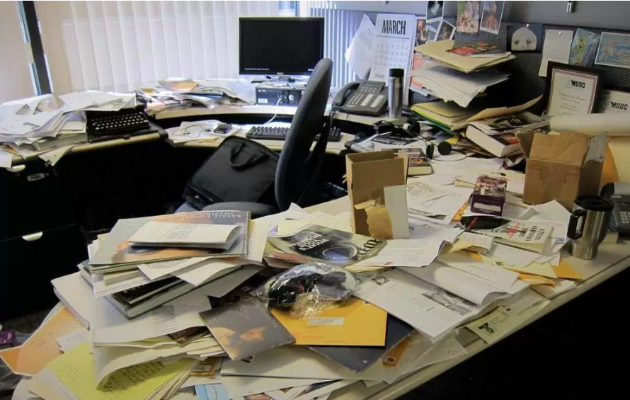
But what does it really look like?
Notes:
It’s important to remember that these documents are not the research. Especially in the computational and statistical sciences, these
documents are the “advertising”. The research is the “full software environment, code, and data that produced the results”. When we separate the research from its advertisement we are making it difficult for others to verify the findings by reproducing them.

Slide 4
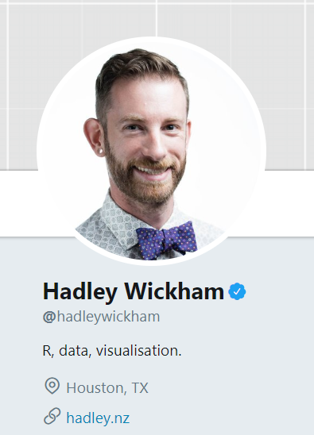
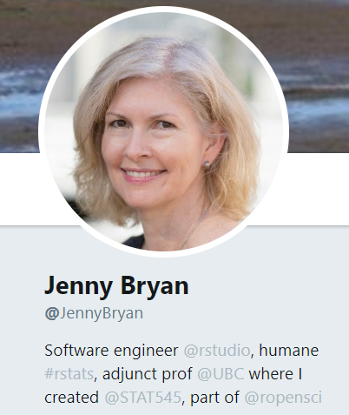
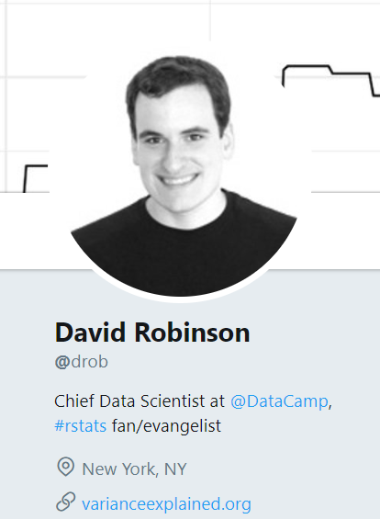
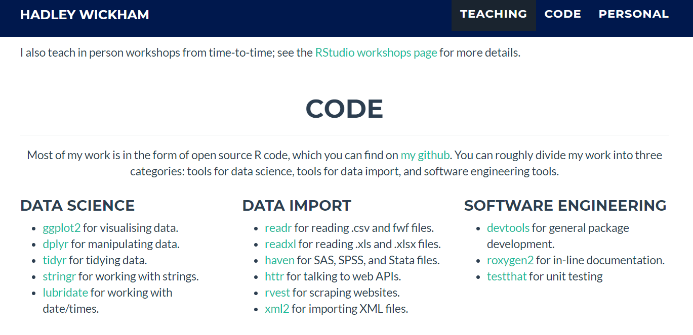
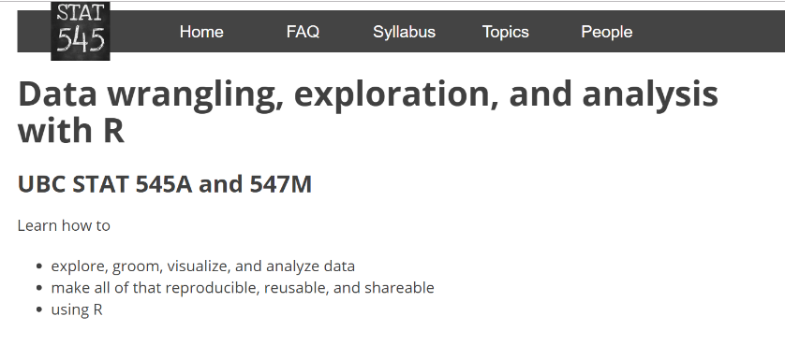
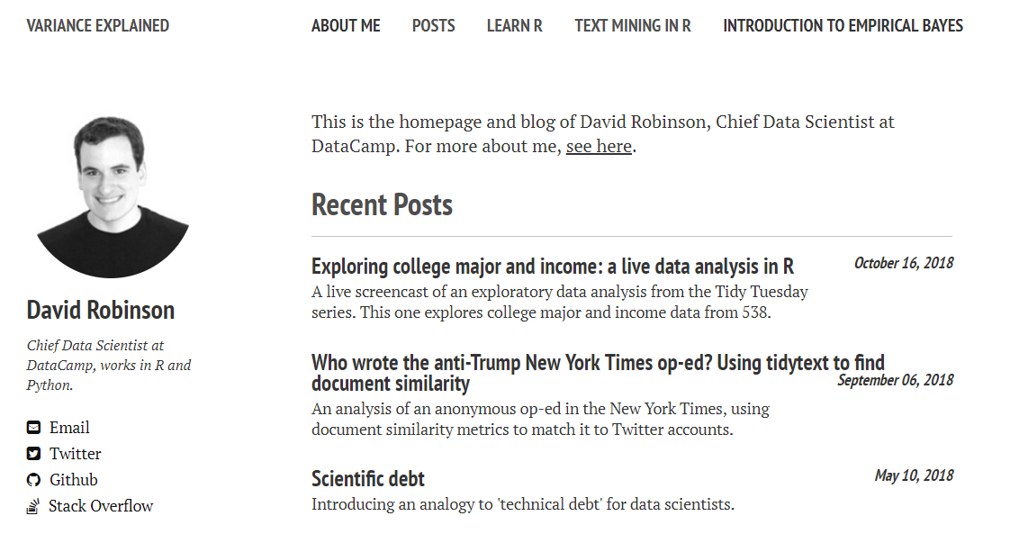
Disclaimer

Slide 5
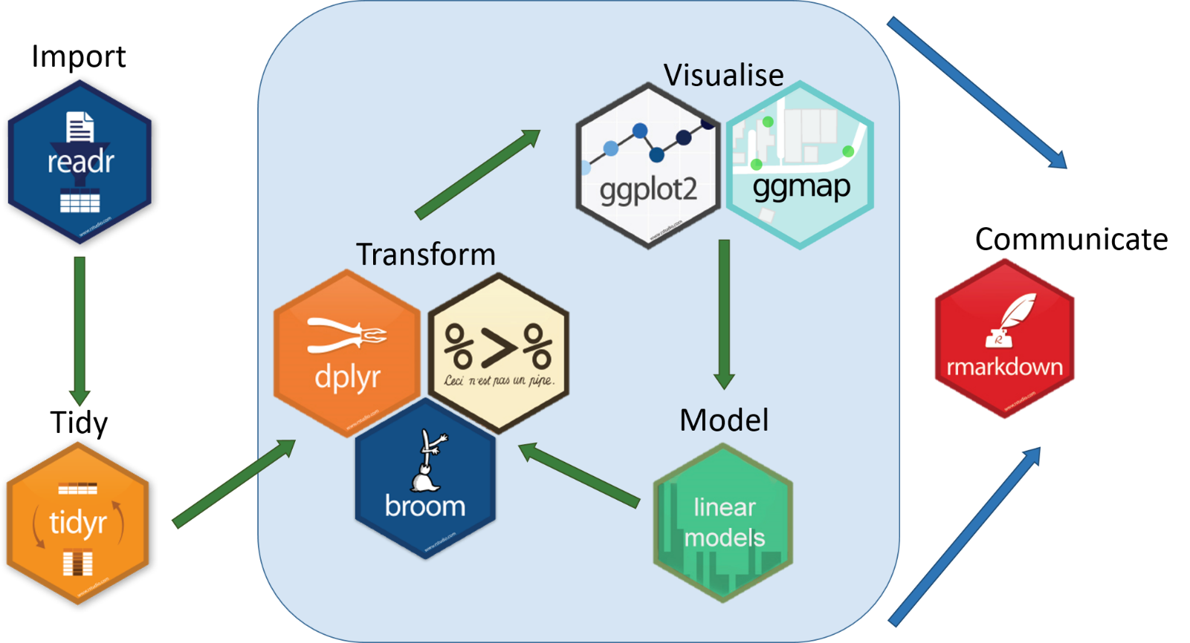
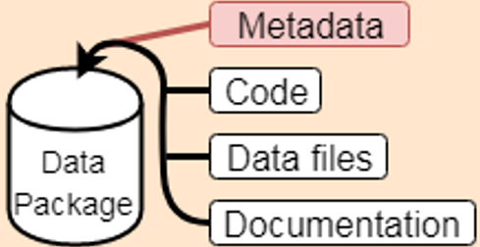
Putting the pieces together
- Data analysis in a tidyverse nutshell
Notes:
As a prelude to much of what I’ll be discussing today is the tidyverse

Slide 6
Putting the pieces together
%>%
Notes:
You can name the intermediate steps but that will results in your environment getting clutters. If you can give something an informative name then do. But oftentimes you have intermediate steps that won’t you need just to get from A –to – B. You can give everything the same name in R but if you make a mistake you have to start from the beginning.
You can also nest your functions but that is hard to read

Slide 7

You could write a book on that!!
R for Data Science webpage
Notes:
We can’t cover everything. Besides, I don’t know everything! Throughout the series, we’ll keep returning tot ggplot as it has applications to every discipline, building up our knowledge at each step. As we tidy our data, our capacity to expand on ggplots functionality will increase. But even at this, we are still only scratching the surface.
FYI, there’s a lot to cover with gplot2. We’re just at the tip of it. Reference book
Why are we diving straight into ggplot2??
Imagine you were going to a party in an unfamiliar area, and asked the host for directions to their house. It takes you thirty minutes to get there, on a path that takes you on a long winding road with slow traffic. As the party ends, the host tells you “You can take the highway on your way back, it’ll take you only ten minutes. I just wanted to show you how much easier the highway is.”
Wouldn’t you be annoyed? And yet this kind of attitude is strangely common in programming education.
I talk to people about teaching a lot, and that phrase keeps popping up: “I teach them X just to show them how much easier Y is”. It’s a trap- a trap I’ve fallen into before when teaching, and one that I’d like to warn others against.
Students don’t share your nostalgia

Slide 8
Putting the pieces together
A: Define a project structure
B: Set a naming convention
C: Use scripted workflows
D: Reproducible research
Notes:
Say something about how if you’re taking over a project, continuing on with a research theme or working as part of a collaboration, you will need to be able to understand what your’re doing and what your colleagues are doing as part of two way communication process

Slide 9
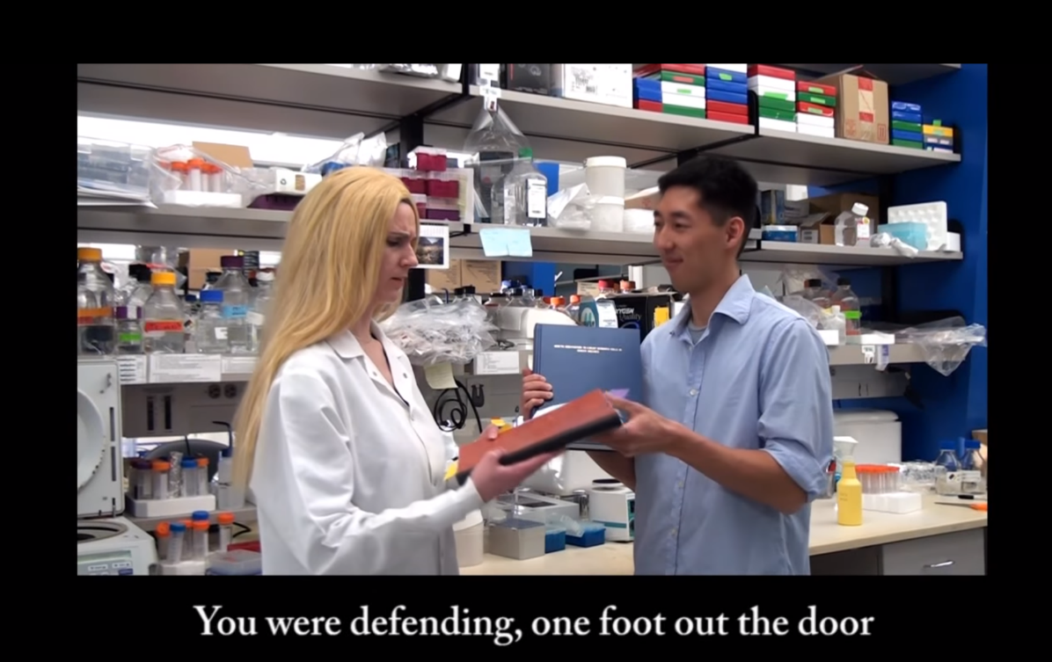
Link to the video on YouTube

Slide 10
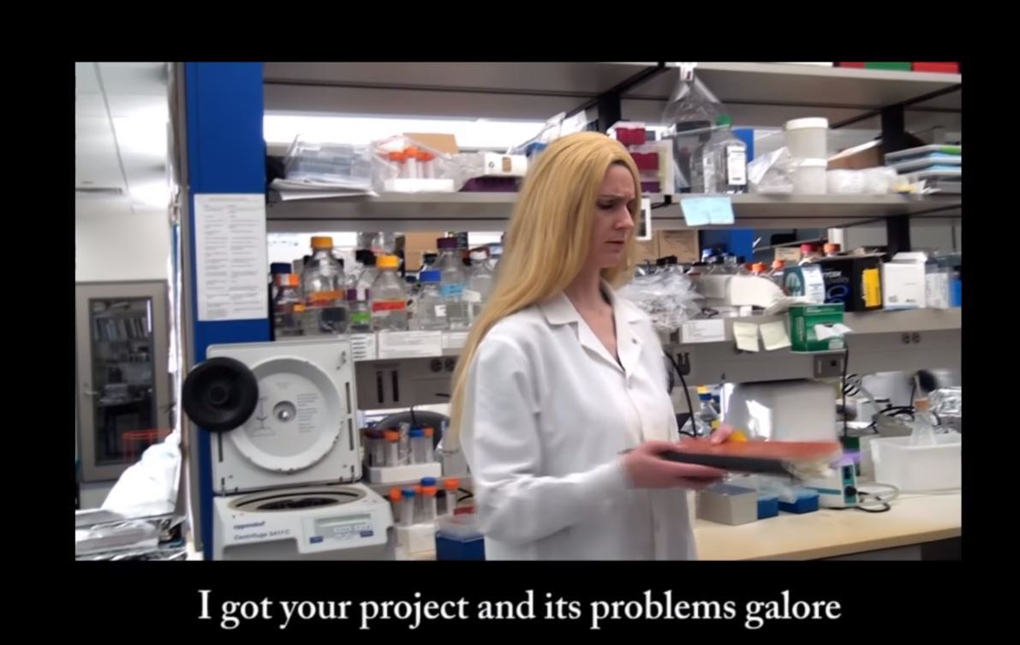
Link to the video on YouTube

Slide 11
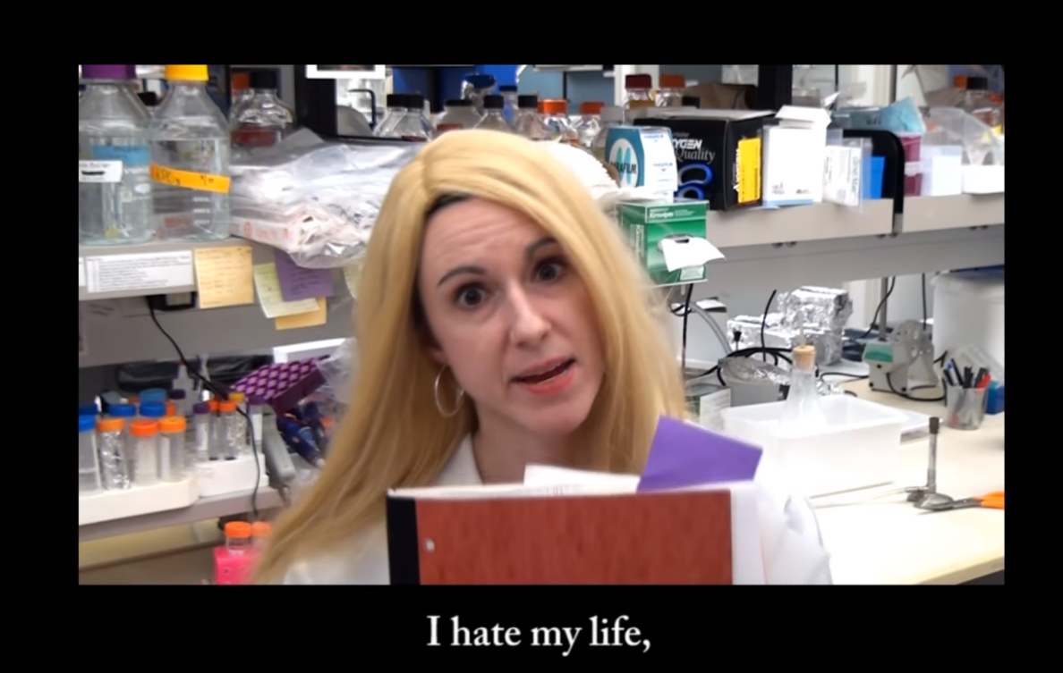
Link to the video on YouTube

Slide 12
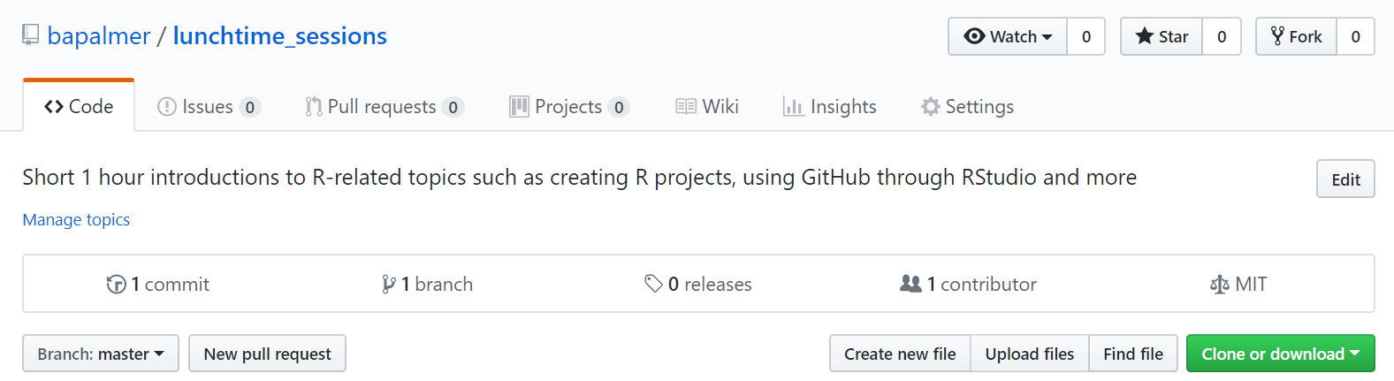
R projects
Here’s one I made earlier……
https://github.com/bapalmer/lunchtime_sessions
Open the R project folder and explore it
Notes:
Talk people through downloading, unzipping and opening the R project

Slide 13
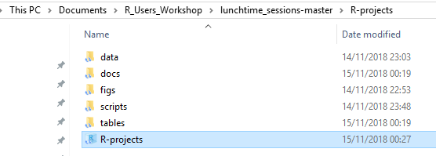
R projects

Slide 14
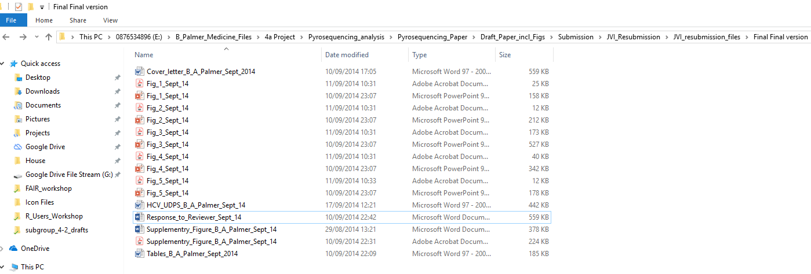
A: Still haven’t found what I’m looking for
- Help your future-self
Notes:
Introduce the topic of past research projects being as much a mystery to you now as they would be to someone else trying to use them
File structure
Folder structure
Naming convention

Slide 15
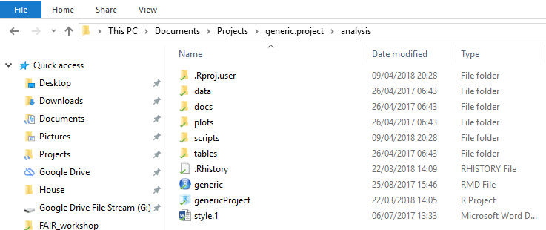
Define a generic project structure
- STEP 1: Give your research projects a shared structure
Notes:
Talk about how if you have the same folder structure you will have an easier time navigating between dissimilar projects.
Don’t rush into a complicated folder hierarchy
Once you need subfolders use the “here” package

Slide 16
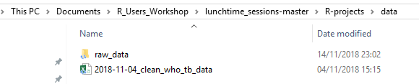
B: Give your files informative names
- STEP 2: Include metadata in the file names
Notes:
Place the raw data under house arrest…
I don’t ever modify the raw, password protected a data files. It also stops you from making manual edits in moments of weakness. Just add that extra line to your cleaning scripts

Slide 17
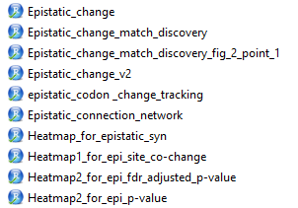
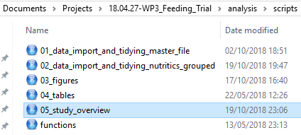
Come back to what you know
- STEP 3: Make you file names machine readable, human readable and work with default ordering
NO
Yes
Notes:
Talk about how if you have the same folder structure you will have an easier time navigating between dissimilar projects.
In the example above the regular expression allows for the files to be selected and retrived
Dates as ISO 8601 YYYY-MM-DD

Slide 18
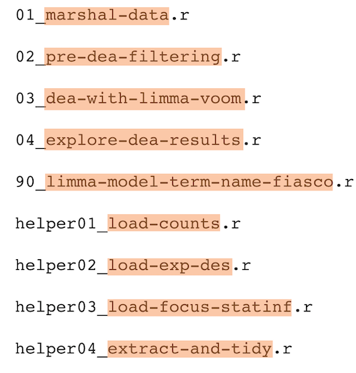
Outline a file naming convention
Machine readable:
Inherent order
Avoid spaces
Avoid punctuation
Remove case-sensitivity
Human readable:
Contains info on content
Avoid spaces
Avoid punctuation
Remove case sensitivity
Metadata:
Separate with underscores (“_”)
Avoid punctuation
Remove case-sensitivity
Image from Data Carpentry webpage
Notes:
Machine Readable:
Easy to search for files
Narrow down the list
Extract info
Human readable:
What files(names do you want to be looking for at 1am before a deadline?????

Slide 19
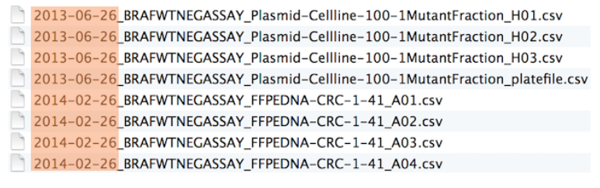
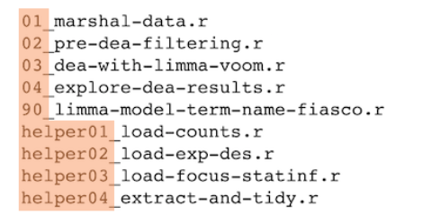
Outline a file naming convention
Chronological order:
Logical order:
Image from Data Carpentry webpage
Notes:
Left pad numbers, i.e. 01, not 1

Slide 20
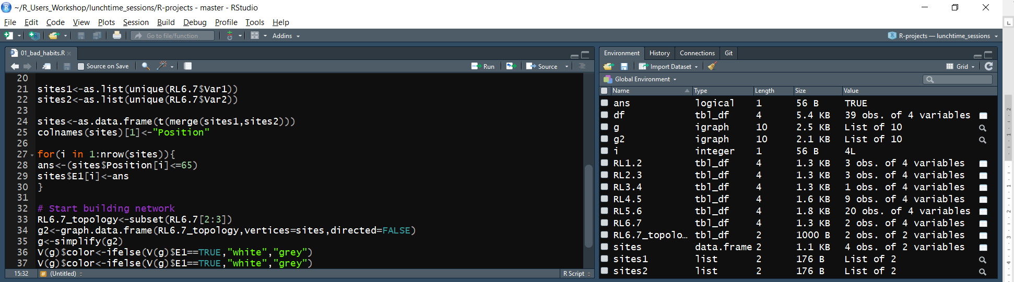
Yesterday
Open the script 01_bad_habits.R
Lack of annotation
Poor naming conventions
Poor readability
Spacing absent
Cluttered environment
Intermediate objects
Notes:
What if you’ve only stored the results of an important calculation in your workspace, rather that the actual calculation in your code

Slide 21
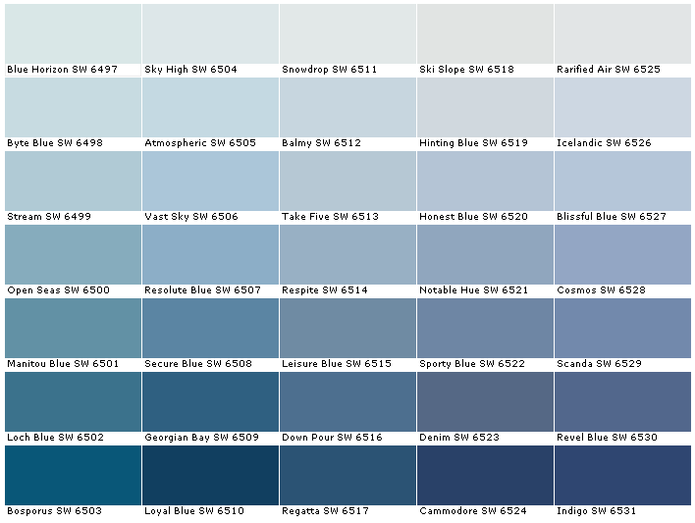
Is too much choice good or bad?
Notes:
Mention tidyverse again
Have any of you tried to paint a room? I like the colour blue. But seriously, which shade of blue do I really, really want?!
How long do I need to dwell over this. There’s 10 more rooms in the house to go!!!!!!

Slide 22
Inconsistent function names, inconsistent syntax
R is a very versatile language
Sometimes it can be too versatile
Do you want to use……
Names or colnames
row.names or rownames
rowSums or rowsum
Sys.time, system.time
Is it written as……
newobject or new.Object
x = 5 or x <- 5
mapping=aes(x,y) or mapping = aes(x, y)
Notes:
R is full of inconsistent function names and inconsistent syntax

Slide 23
Writing clearer code
Annotation
Object names
should use only lowercase letters, numbers, and “_”
Spacing
Put a space before and after =
Put a space after a ,
Operators should be surrounded by spaces e.g. ==, <-, +
For a more complete list visit
http://style.tidyverse.org/syntax.html
Open the script 02_good_habits.R

Slide 24
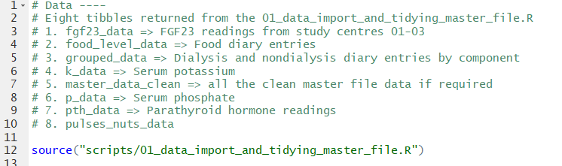
C: Joined up thinking
The R scripts you generate should be human readable
Annotate the code
Break up the scripts into dedicated tasks
Interlink with other within project scripts
Notes:
Here the script I am using to generate figures from the study is calling on the script used to clean and return the data files to be used.
This has the added advantage of the script not being cluttered and dedicated to the task at hand.

Slide 25
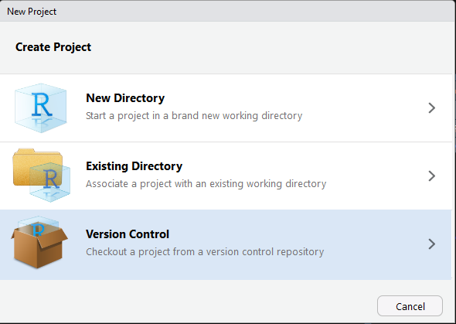
D: Setting up an R project
Notes:
Spend some time orientating them around the sample project

Slide 26
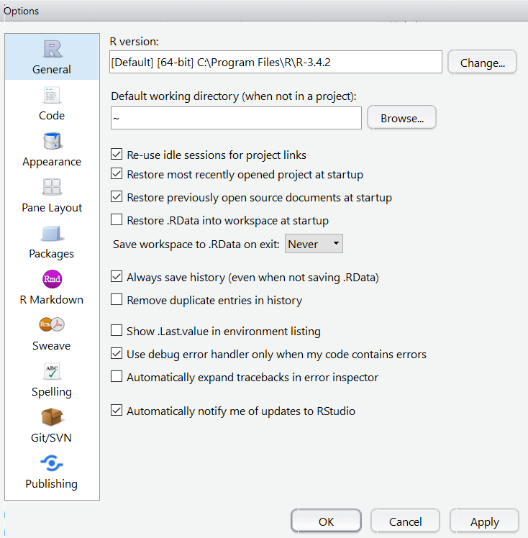
Other points to note
You might consider your environment as “real”
If you continue to use R, it is better for you to consider your R scripts as “real”, as these should recreate the environment
You may suffer short term pain
This will prevent long term agony
Notes:
What if you’ve only stored the results of an important calculation in your workspace, rather that the actual calculation in your code

Slide 27
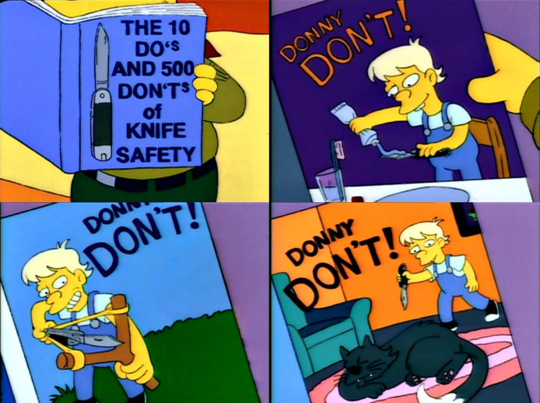
Don’t Do What Donny Don’t Does!!
Donny Don’t:
Start your script with setwd()
Donny Don’t:
Start your script with… rm(list = ls())
Donny Don’t:
Start your script with… setwd()
Notes:
The chance of the setwd() command having the desired effect – making the file paths work – for anyone besides its author is 0%. It’s also unlikely to work for the author one or two years or computers from now. The project is not self-contained and portable.
The problem is that rm(list = ls()) does NOT, in fact, create a fresh R process. All it does is delete user-created objects from the global workspace.
It makes your script vulnerable to hidden dependencies on things you ran in this R process before you executed rm(list = ls()).

Slide 28
Everything in its right place
benefits of using R projects for data analysis tasks
Open the script 03_data_cleaning.R
Open the script 04_plots.R
Open the script 05_tables.R
Open the script 06_analysis.R

Slide 29

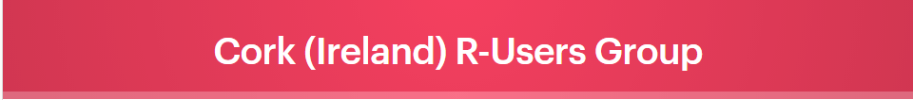

Notes:
One of the outcomes of this workshop is to look at developing a group of R users in Cork who are willing to come together and solve one another's problems and share experiences of using new packages and features.

